Slide 1

Python Programming Midterm Project
NYC Crimes Data Analysis
Samyak Meshram
Nidhi Berde
Pace University

Slide 2
Introduction
This Dataset includes all valid felony, misdemeanor and violation reported to the New York City Police Department till the year 2021. After cleaning the data, we will analyze various crimes that happen in NYC, boroughs that are affected the most, location and time of crimes, Seasonal Crimes etc.
This dataset is taken from NYC Open datasets and is based on the NYC complaints dataset. This project will help us to analyze the safe neighborhoods in NYC, details of potential crimes happening in NYC, understand them and take appropriate measures for safety.

Slide 3




Problem Definition
To clean and perform Exploratory Data Analysis on the NYC Crimes dataset to form meaningful conclusions.
Cleaning the data, checking for null values, removing columns not necessary for analysis.
Using visualisations to determine insights about the data.

Slide 4
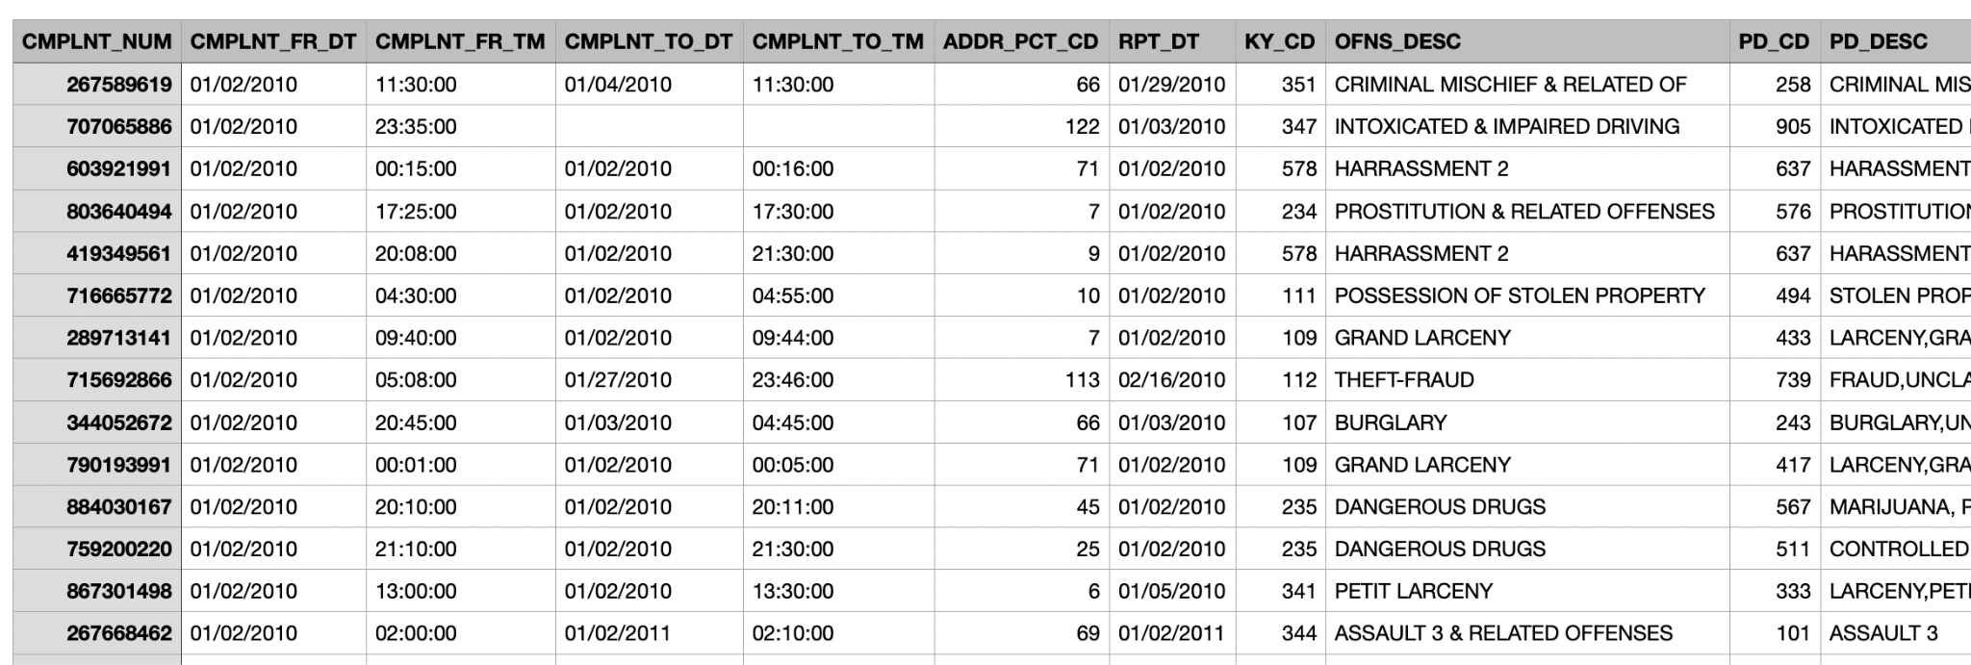
Dataset
This Dataset has been obtained from nycopendata.com
The dataset contains all the data from 10 years ( 2010-2021 )
The important columns that were used for analysis are Complaint start date, borough names, offense type, location, age groups.

Slide 5
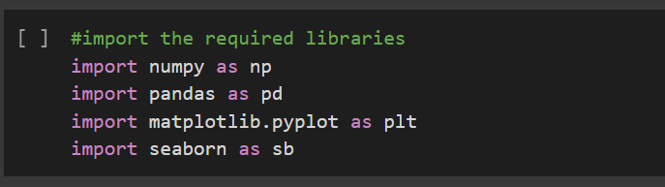
Importing Libraries
Numpy and pandas has been used for data preprocessing and matplotlib and seaborn for visualisations.

Slide 6


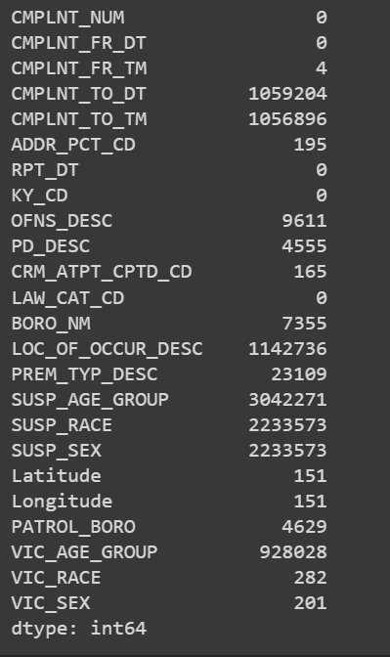
State of Data

Slide 7
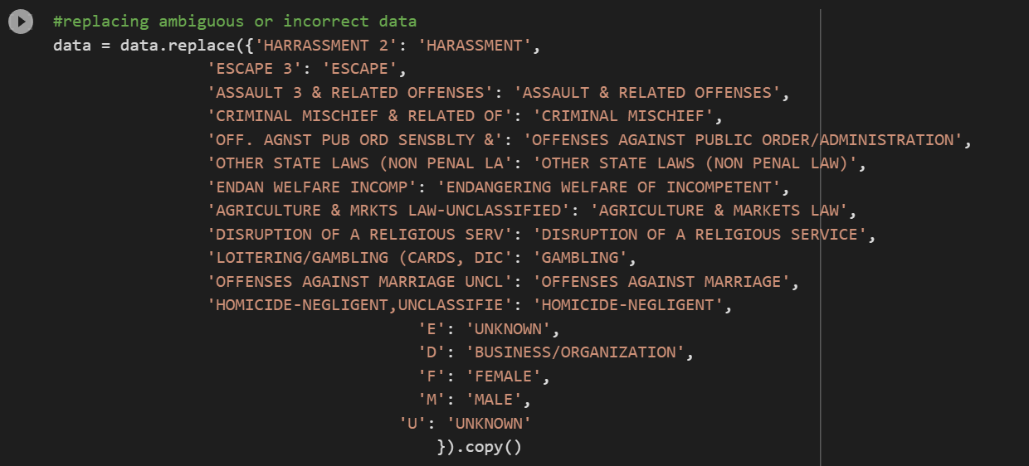
Replacing Data

Slide 8
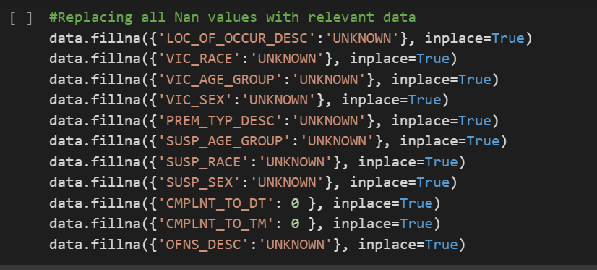
Filling null values with relevant data

Slide 9
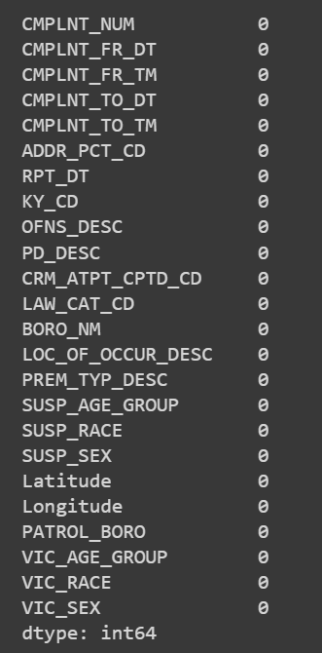

Cleaned Data

Slide 10
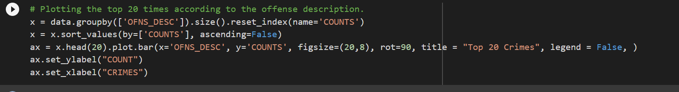
Top 20 Crimes

Slide 11
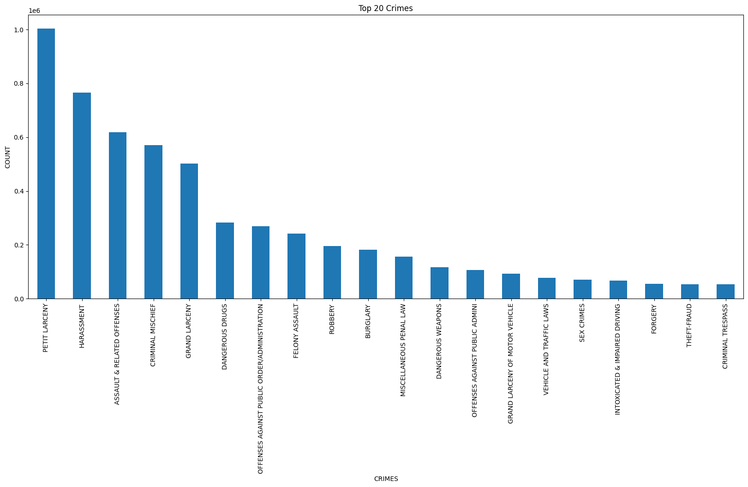

Slide 12
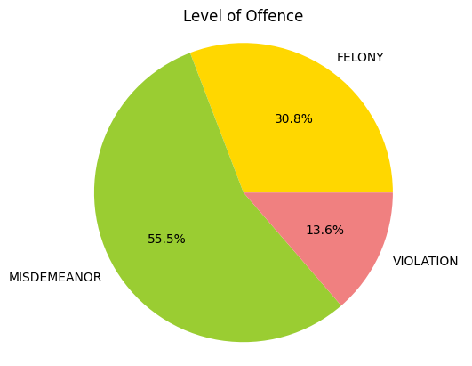
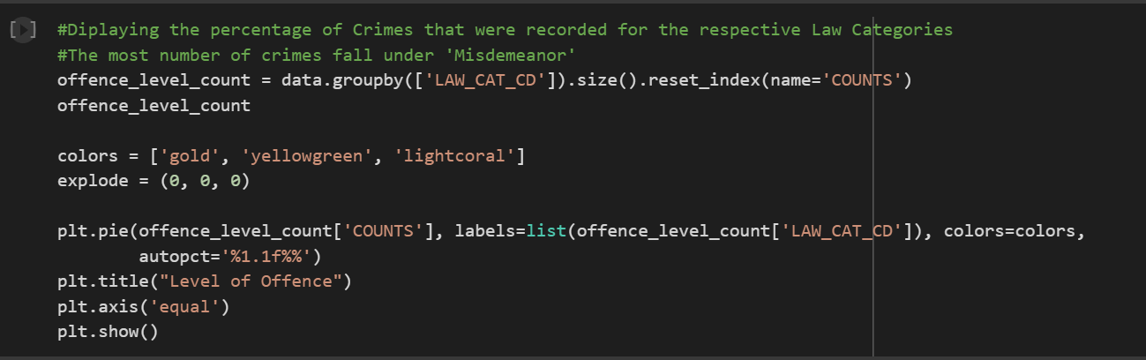
Crime Level analysis

Slide 13
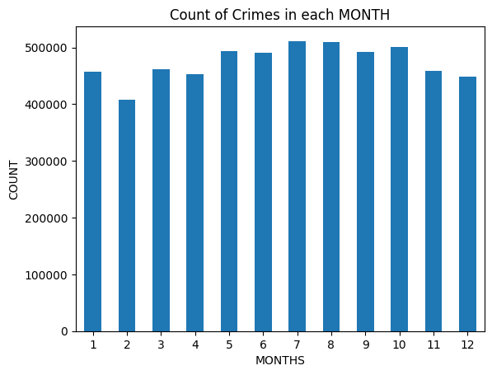
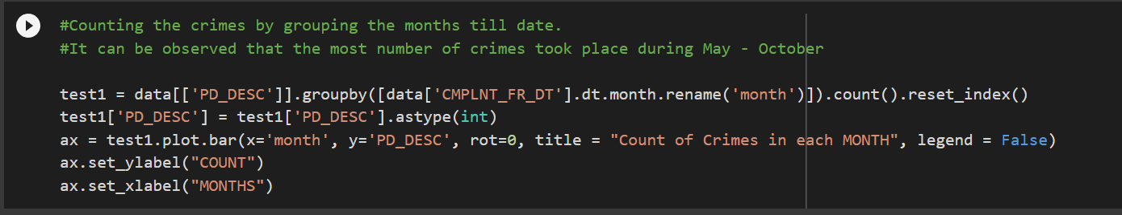
Analysis of Crimes wrt to month.

Slide 14
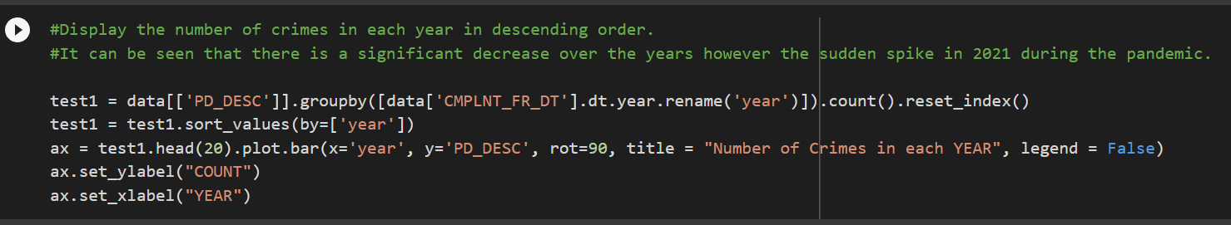
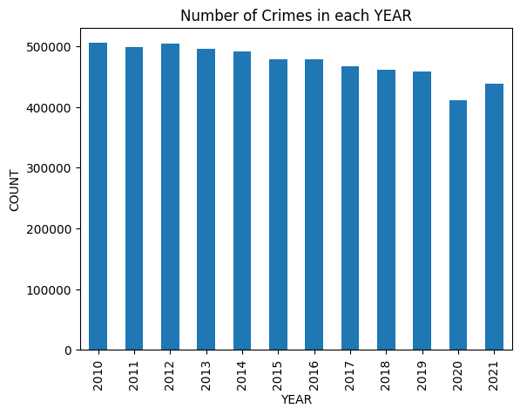
Number of crimes occurred in each year

Slide 15
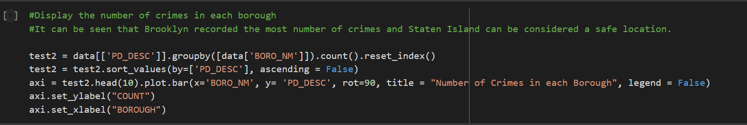
Number of crimes registered in each Borough

Slide 16
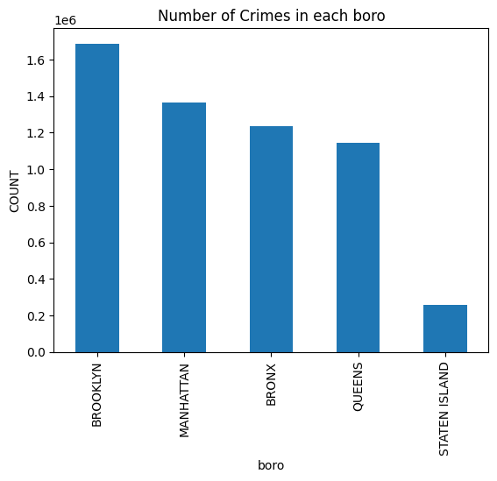
Crimes by Boroughs Analysis

Slide 17
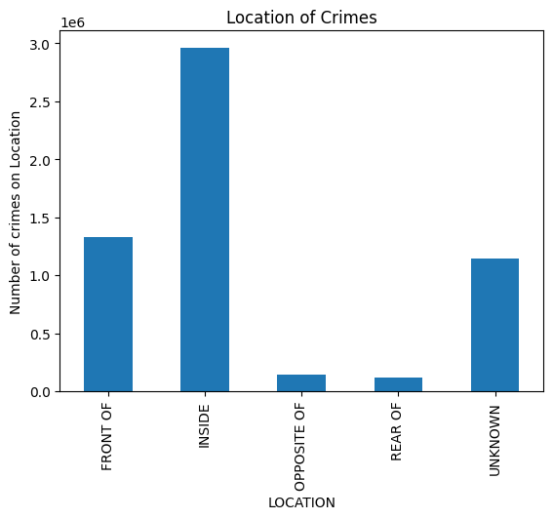
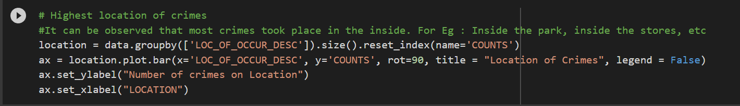
Location of Crimes

Slide 18
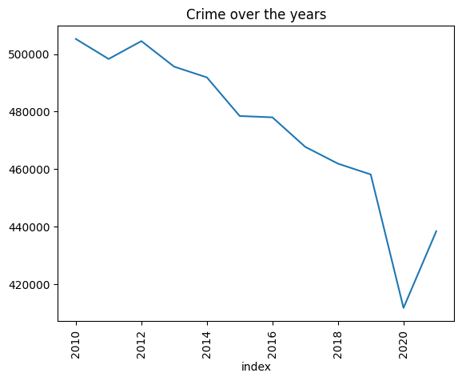
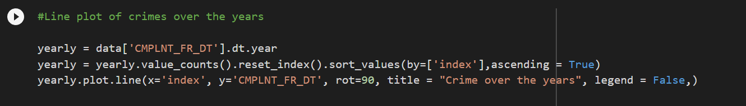
Crimes Over the years

Slide 19
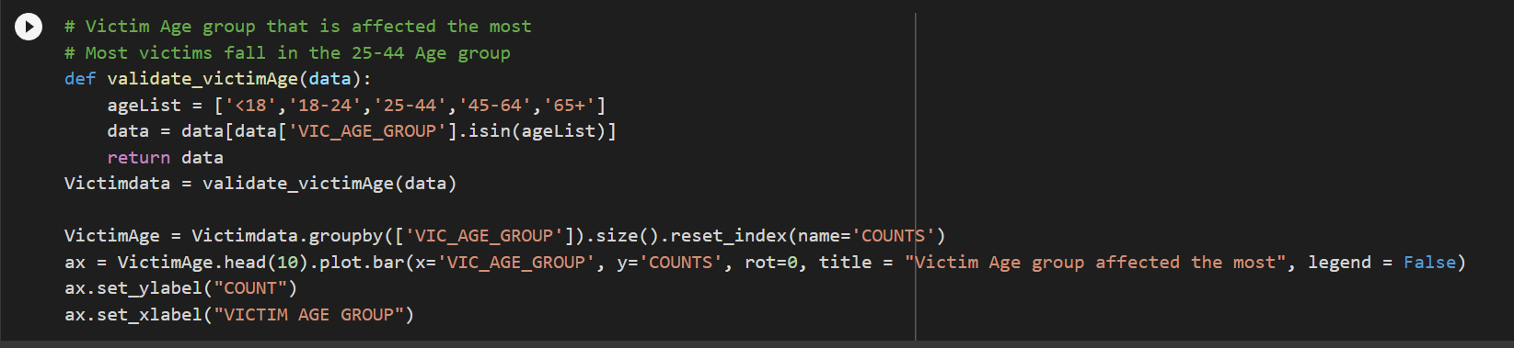
Victim Age Groups

Slide 20
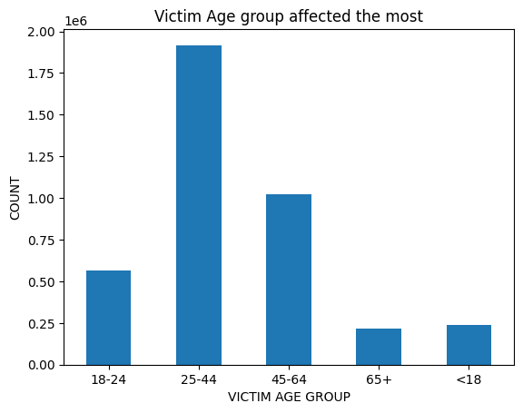

Slide 21
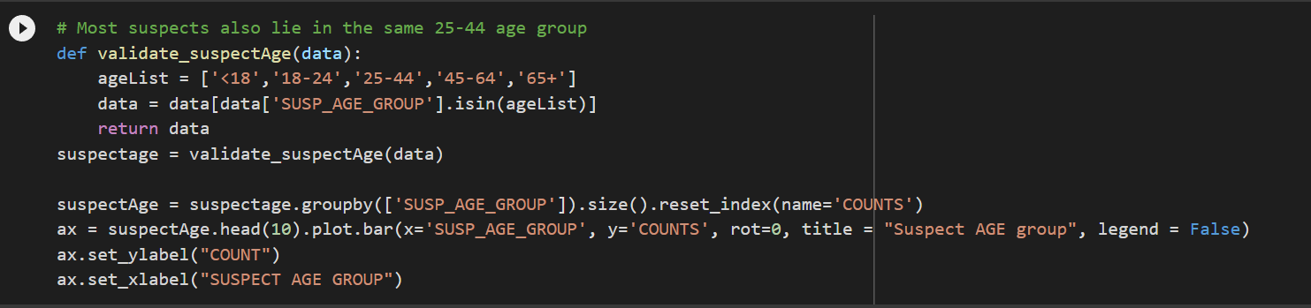
Suspect Age Group

Slide 22
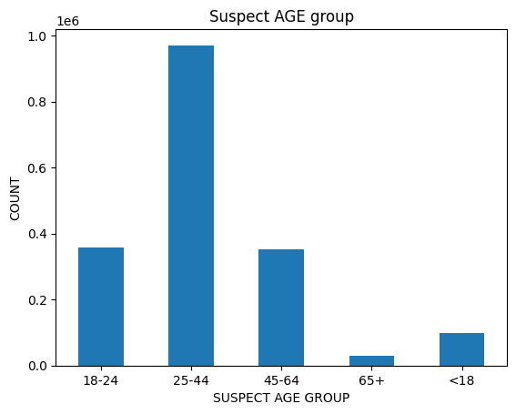

Slide 23
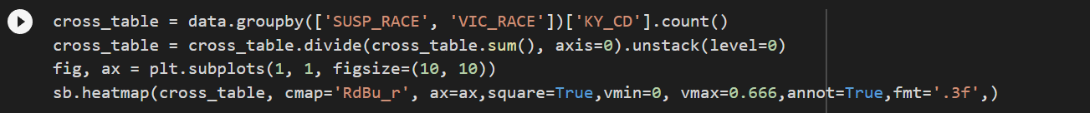
Correlation between suspect and Victim Races

Slide 24
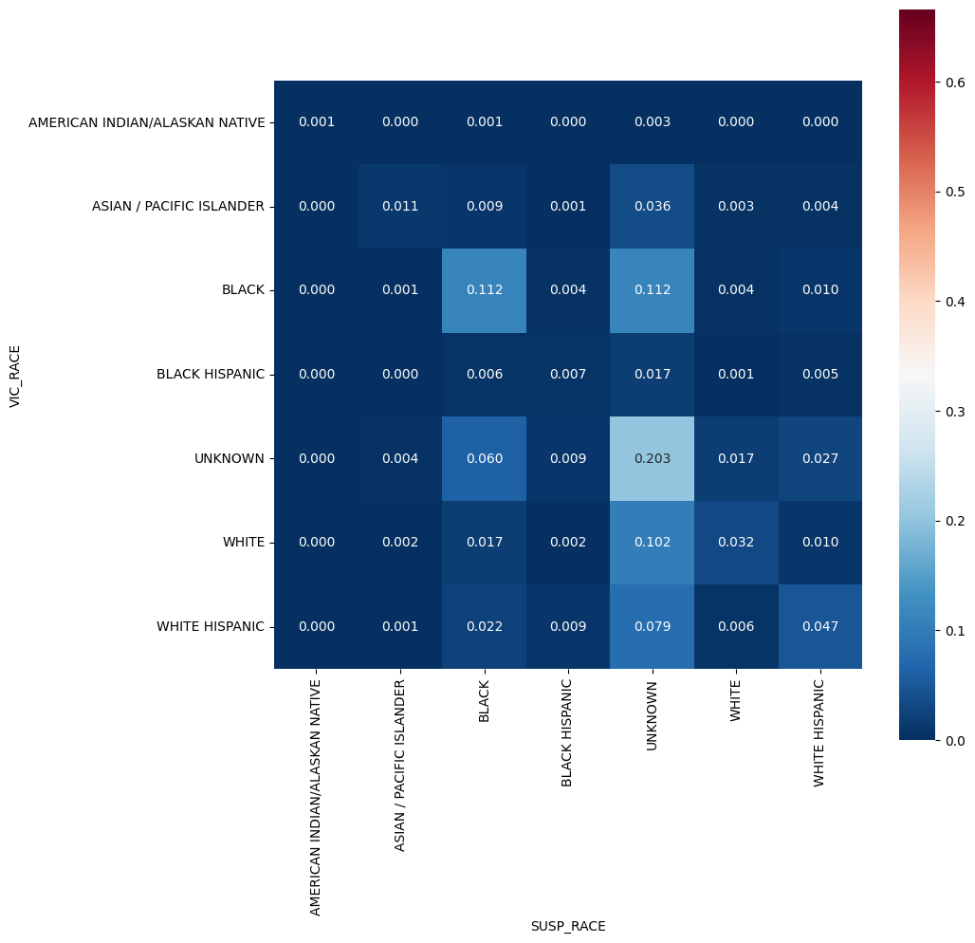

Slide 25

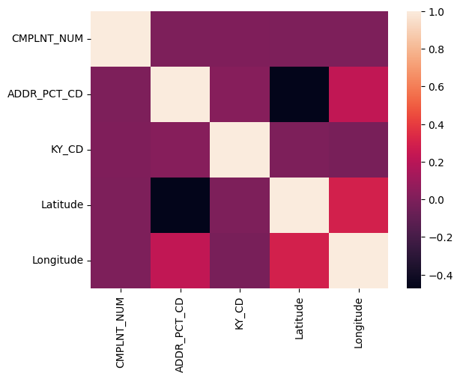
Correlation between data values

Slide 26
Conclusion
It can be observed that the greatest number of crimes took place in Brooklyn and Manhattan whereas Staten Island was the safest
‘Misdemeanor’ is the largest category of crime.
Most number crimes occurred in 2010 and the crimes have been gradually decreased, however with increase from 2020-2021
Most number of crimes took place in a closed environment.
Most number of crimes took place during May-October.
Highest victim and suspect age group is 25-44yrs
Appropriate measures such as use of CCTV, increasing the time of patrolling ,etc can be taken using the analysis.

Slide 27
Thank you

